Slide 2
CAS Basics

Slide 3
Learning Goals
Identify approaches to quality assurance and the use of professional standards in higher education
Describe CAS and the CAS standards
Articulate how the CAS standards can be used for program self-assessment

Slide 4
Council for the Advancement of Standards in Higher Education
Founded in 1979 (40th Anniversary)
Consortium of 42 member organizations
Council comprised of representatives from member associations
Consensus-oriented, collaborative approach
48 sets of functional area standards and self-assessment guides (SAGs)
3 Cross-Functional Frameworks
Notes:
For more than 40 years, the Council for the Advancement of Standards in Higher Education (CAS) has promoted inter-departmental, inter-program collaboration and reflected good practices generally agreed upon by the student affairs -profession-at-large.
CAS emerged from a movement on the part of several national associations to develop accreditation standards for academic preparation programs for counselors and counselor educators and for student affairs administrators and educators. CACREP (Council for the Accreditation of Counseling and Related Educational Programs) was established in 1980 to address preparation standards for counselor education programs; and ACPA took the lead on creating a set of preparation standards for master’s level college student affairs programs. ACPA invited other interested associations to join this effort, and it resulted in the creation CAS – “an inter-association consortium for purposes of developing and promulgating professional standards to guide both student affairs practice and academic preparation of those who administer student support programs and services” (CAS, 2).
CAS has adopted a consensus-based decision-making model for reviewing and revising standards of professional practice. Working toward consensus requires dialogue and compromise; the rewards are shared understanding, unanimous agreement, and standards applicable across different contexts. By seeking consensus around each set of CAS standards, collective expertise emerges above individual experiences and perspectives.
CAS has developed and promulgated standards for quality enhancement of higher education programs and services through self assessment.

Slide 5
CAS Functional Areas
Internship Programs
Learning Assistance Programs
LGBTQ+ Programs and Services
Master’s Level Student Affairs Professional Preparation Programs
Multicultural Student Programs and Services
Orientation Programs
Parent and Family Programs
Post-Traditional and Commuter Student Programs and Services
Registrar Programs and Services
Sexual Violence-Related Programs and Services
Student Conduct Programs
Student Leadership Programs
Student Media Programs
Sustainability Programs
Testing Programs and Services
Transfer Student Programs and Services
TRIO and College Access Programs
Undergraduate Admissions Programs and Services
Undergraduate Research Programs
Veterans and Military-Connected Programs and Services
Women’s and Gender Programs and Services

Slide 6
Criteria for Professionalism
Established philosophy is in place
Professional preparation exists with a body of knowledge
Research is underway developing theories and analyzing practice
Professionals are employed full-time
Professional organizations are in place
Professional standards are established
Notes:
A standard to guide practice is an essential characteristic of any established profession. During the evolution of a mature profession, it is vital that relevant standards be developed and promulgated by and for those working in that arena. CAS was founded as a profession-wide entity to establish reasonable and achievable standards to guide practice of those educators supporting students in post-secondary institutions.

Slide 7
CAS Vision and Mission
CAS Vision
Setting the standard for quality in higher education.
CAS Mission
CAS, a consortium of professional associations in higher education, promotes the use of its professional standards for the development, assessment, and improvement of quality student learning, programs, and services (CAS, 2015).
Notes:
CAS is a consortium of professional associations who work collaboratively to develop and promulgate standards and guidelines and to encourage self-assessment.

Slide 8
Principles Underlying All CAS Standards
Students and Their Environments
Parts 1. Mission; 2. Programs and Services; 3. Student Learning, Development, and Success, and 4. Assessment
Advocating for Diverse, Equitable, and Inclusive Communities
Part 5. Access, Equity, Diversity, and Inclusion
Notes:
Students and Their Environments
The whole student is shaped by environments that provide learning opportunities reflective of society and diversity, with students having ultimate responsibility for learning
Advocating for Diverse, Equitable, and Inclusive Communities
Institutions embracing diversity, equity, inclusion and eliminating barriers with respect for differences and focused on culturally responsible communities

Slide 9
Organization, Leadership, and Human Resources
Parts 6. Leadership, Management, and Supervision; 7. Human Resources; and 8. Collaboration and Communication
Ethical Considerations
Part 9. Ethics, Law, and Policy
Learning-Conducive Structures, Resources, and Systems
Parts 10. Financial Resources; 11. Technology; and 12. Facilities and Infrastructure
Notes:
Organization, Leadership, and Human Resources
Quality of leaders continuously challenge themselves for the betterment of the organization, with success directly correlated to clarity of mission and willingness to see through multiple lenses.
Ethical Considerations
Educators exhibit impeccable ethical behavior in professional and personal life
Learning-Conducive Structures, Resources, and Systems
Student learning and development flourish when structures, resources, and systems are employed intentionally to create environments that provide students with appropriate challenge and necessary

Slide 10
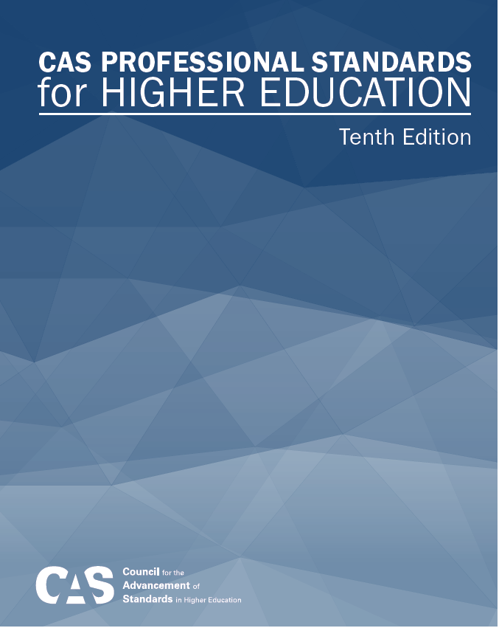
Applications for CAS Standards
Design new programs and services
Focus time, energy, and resources
Devise staff development
Guide strategic planning
Develop learning and development outcomes
Measure program and service effectiveness
Notes:
CAS materials are easy to use in several different ways, and they can be helpful for programs, departments, or divisions. Examples of CAS uses include:
Identify better uses for funds
Consider what are the essential, non-negotiable functions
Determine what is covered at training, what skills are needed to be effective, etc.
Establish credibility and accountability
Enhance institutional self-studies to prepare for accreditation
CAS Standards and self-study processes provide for flexibility (even within the same campus). Some considerations for using CAS to fit your culture and environment:
Institutional Size
Institutional Type
Cross-functional areas
Multiple Sites

Slide 11
The General Standards (2018)
Mission
Program and Services
Student Learning, Development, and Success
Assessment
Access, Equity, Diversity, and Inclusion
Leadership, Management, and Supervision
Human Resources
Collaboration and Communication
Ethics, Law, and Policy
Financial Resources
Technology
Facilities and Infrastructure
Notes:
A number of characteristics are common to all functional areas, and these commonalities demand inclusion in all current and future CAS standards. As a result, General Standards were devised that CAS Board members unanimously agreed were relevant to all the functional areas within student support programs and services championed by CAS member associations.
The General Standards are arranged into 12 sections, which appear in CAS standards and assessment tools to provide direction for different facets of programs/services.
Functional Area standards are in various stages of revision – some committees have just been charged, while others are out for expert review
A note about the General Standards: They are revised every 3 years to maintain relevancy and currency in the field.

Slide 12
Standards are comprised of Two Types of Statements
General Standards
Common across all functional areas
Appear verbatim in every set of functional area standards
The functional area must develop and define its mission.
Functional Area Standards
Address issues specific to the functional area.
The mission of Career Services (CS) is to assist students and other designated clients in developing, evaluating, and implementing career, education, and employment readiness goals.
Notes:
Each functional area is a hybrid of General Standards – which CAS has agreed apply across all units – and those more specialized standards that address unique elements for programs and services.

Slide 13
Understanding Standards & Guidelines
Standards
Guidelines
Indispensable requirements
Clarify & amplify Standards
Achievable by any & all programs of quality
Guide enhanced practice beyond essential function
Appear in bold type
Appear in light-faced type
Use must & shall
Use verbs should & may
Notes:
One of the things that can get confusing about the CAS language is that we talk about both “standards and guidelines.” This slide explicates some of the distinctions.
Sets of standards vs. statements of standards
Standards and guidelines are basic statements that should be achievable by any program in any institution when adequate and appropriate effort, energy, and resources are applied
Standards reflect a level of good program practice generally agreed upon by the profession at large

Slide 14
CAS Learning and Domains and Dimensions

Slide 15
Student Learning, Development, and Success Section
Six Student Learning & Development Outcome Domains are a part of the CAS General Standards
Stated expectation in the CAS General Standards that all functional area programs must place emphasis on identifying relevant learning outcomes and assessing their achievement by students
Notes:
Outcomes are classically understood to be changes that occur as a result of some aspect of the college experience (Astin, 1991).
Standards serve a purpose in leading towards intentional outcomes
CAS identifies 6 learning outcomes to address the whole student
Each functional area either directly influences, contributes or makes outcome possible
Some outcomes may be more significant to a program/service than others but all should be on radar
Critically important to think first of desired outcomes and then design programs that will get us there
Standards, outcomes, and assessment lead us to accountability.

Slide 16
CAS Learning and Development Outcomes
Part of the CAS General Standards
Knowledge acquisition, construction, integration, and application
Cognitive Complexity
Intrapersonal Development
Interpersonal Competence
Humanitarianism and Civic Engagement
Practical Competence
Notes:
Gavin

Slide 17
Student Learning, Development, and Success Section
The functional area MUST…
Provide evidence of the extent to which student learning and development outcomes are achieved
Use evidence to create strategies for improving student learning, development, and success

Slide 18
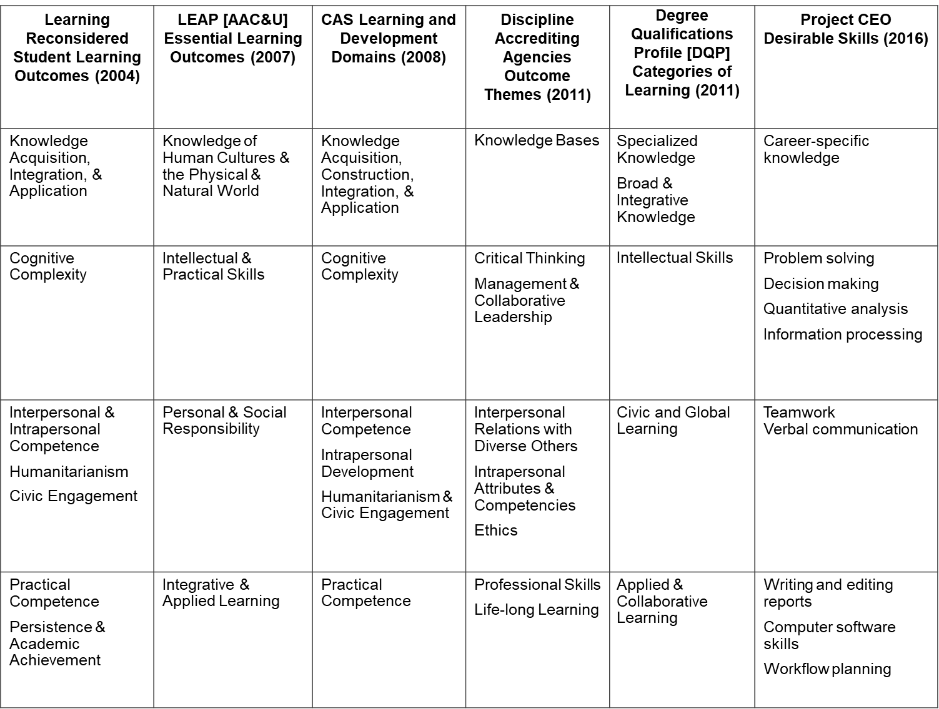
Notes:
Mapping CAS outcomes against other learning outcomes
The CAS Learning and Development Outcomes dovetail with numerous other set of learning outcomes being promulgated and used across higher education. Recognizing the overlap and identifying places where we use different work to say similar things can help us build shared understanding across divisions, units, departments, or campuses.
When the CAS domains were created, we looked at what was emerging across various groups that were working on outcomes, and true to CAS practice, came together to codify and enhance what had emerged. The result was the current CAS Learning and Development Outcomes domains and dimensions.
Liberal Education and America's Promise (LEAP) Essential Learning Outcomes (AAC&U)
Knowledge of Human Cultures and the Physical and Natural World - Through study in the sciences and mathematics, social sciences, humanities, histories, languages, and the arts Focused by engagement with big questions, both contemporary and enduring
Intellectual and Practical Skills (Including Inquiry and analysis, Critical and creative thinking, Written and oral communication, Quantitative literacy, Information literacy, Teamwork and problem solving) - Practiced extensively, across the curriculum, in the context of progressively more challenging problems, projects, and standards for performance
Personal and Social Responsibility (Including Civic knowledge and engagement—local and global, Intercultural knowledge and competence, Ethical reasoning and action, Foundations and skills for lifelong learning) - Anchored through active involvement with diverse communities and real-world challenges
Integrative and Applied Learning (Including Synthesis and advanced accomplishment across general and specialized studies) - Demonstrated through the application of knowledge, skills, and responsibilities to new settings and complex problems
Disciplines Qualitative Content Analysis
Study of learning outcomes articulated by 25 disciplinary accrediting agencies registered with Council for Higher Education Accreditation (CHEA)
211 outcomes were analyzed, and the criteria for outcomes included were:
Learning outcomes that were applicable at a broad thematic level were selected for inclusion
Non-discipline specific outcomes were included
Degree Qualifications Profile (Lumina Foundation)
The DQP organizes the learning outcomes (proficiencies) of degrees according to five broad interrelated categories:
Specialized Knowledge – addresses what students in any specialization should demonstrate with respect to the specialization beyond the vocabularies, theories and skills of particular fields of study.
Broad and Integrative Knowledge – asks students at all three degree levels to consolidate learning from different broad fields of study (e.g., the humanities, arts, sciences and social sciences) and to discover and explore concepts and questions that bridge these essential areas of learning.
Intellectual Skills – includes both traditional and nontraditional cognitive skills: analytic inquiry, use of information resources, engagement with diverse perspectives, ethical reasoning, quantitative fluency and communicative fluency. Throughout, the DQP emphasizes the importance of students making, confronting and interpreting ideas and arguments from different points of reference (e.g., cultural, technological, political).
Applied and Collaborative Learning – emphasizes what students can do with what they know. Students are asked to demonstrate their learning by addressing unscripted problems in scholarly inquiry, at work and in other settings outside the classroom. This category includes research and creative activities involving both individual and group effort and may include practical skills crucial to the application of expertise.
Civic and Global Learning – recognizes higher education’s responsibilities both to democracy and the global community. Students must demonstrate integration of their knowledge and skills by engaging with and responding to civic, social, environmental and economic challenges at local, national and global levels.

Slide 19
Creating Intentional Outcomes
CAS learning and development outcomes address the whole student
Functional areas directly influence or contribute to each outcome
Outcomes may be more significant to a program or service than others; all should be on radar
Identify desired outcomes before designing programs
Input
Environment
Outcome

Slide 20
Fundamental Assessment Questions
Student Learning and Development Outcomes
What is the effect of our work on students?
How are they different as a result of interacting with our programs and services?
How do we know?
How do we demonstrate their learning?
What and how do we measure?
Program Evaluation
Is the program or service functioning effectively to achieve its mission?
What evidence is available to support the determination?
Learning and development outcomes are part of this evidence
How is evidence used to make program decisions?
Notes:
Assessing student outcomes and evaluating program outcomes must be approached differently, since the results will answer very different questions about a program/service. Understanding the complimentary roles of student outcomes and program outcomes within a review/self-assessment can help personnel gather appropriate evidence in response to different standards for practice.

Slide 21
Applying the Outcomes
Writing learning outcome statements
Aligning learning experiences across an institution
Guiding assessment plans
Engaging students in learning opportunities
Preparing for a self-assessment

Slide 22
CAS Self-Study
Overview and Application

Slide 23
CAS Fundamentals about Self-Assessment
Internally driven
Systematic and regular
Effective in terms of time, cost, etc.
Provides reasonably accurate, useful information
Supports staff development
Provides recognition and rewards at a local level
Notes:
Although CAS standards can be useful for institutional and program accreditation purposes, CAS has not established an accrediting or credentialing process. CAS recognizes individualized institutional and program “self-regulation” as the ideal approach to ensuring program quality and effectiveness. Self-regulation is motivated and directed within an institution; goals of self-regulation are to create, maintain, and enhance high-quality programs and services. Programs and services committed to self-regulation continually assess their work, identify areas for improvement, and address those needs to maintain high quality programs and services. Philosophically, CAS perceives this approach as preferable to externally motivated regulation, because individuals within an institution have clear understanding of its mission, goals, resources, and capabilities.

Slide 24
CAS Fundamentals about Self-Assessment
Charts quality program development and professionalism using widely agreed-upon quality indicators
Develops a shared vision among constituents
Relies on honesty with meticulous evaluation
Assembles results into an action plan for improvement

Slide 25
Self-Assessment Guides (SAGs)
Provides an effective workbook/format for evaluation, self-assessment, and institutional reviews
Translates standards into multiple criterion statements which can be measured
Clusters of criterion measures focus on subsections of the standards, allowing raters to express detailed and targeted judgments
Informs on program strengths and weaknesses
Leads to an action plan to enhance programs and services that benefit student learning and development
Notes:
CAS functional area standards are used most often by practitioners as a critical component of a comprehensive assessment plan and program evaluation. CAS provides tools and processes to guide practitioners through a self-assessment or program evaluation
The CAS process for conducting a comprehensive self-assessment of programs and services and student outcomes begins with the CAS SAG or Self Assessment Guide. The SAG serves several functions, detailed on this slide.

Slide 26
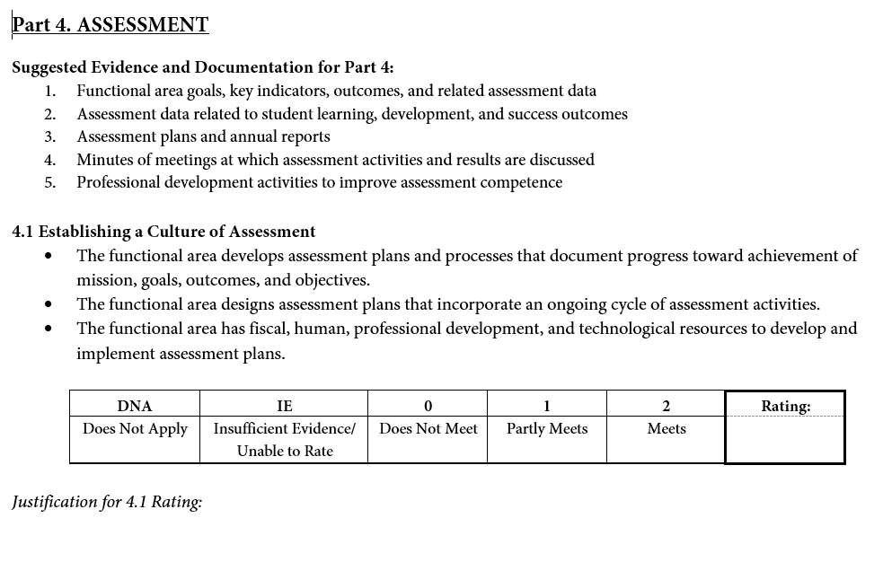
2019 CAS SAG
Recommendations for each part
for evidence to gather
Clusters of criterion measures
(means fewer items to rate!)
Space for rating of each subpart (ex: 4.1)
- Simplified scale for evaluation -
Space to write your narrative explanation of above ratings
Notes:
Each self-assessment guide (SAG) has a similar structure. The SAG structure was significantly revised with the 2015 publication, and has received additional updates in the 2019 publication. The 2019 version features a simplified scale, with the previous “exceed expectations” removed. The CAS standards reflect a level of good practice generally agreed upon by the profession at large. Criterion measures are now clustered into categories for rating which are mirrored in the revised and updated standards; this reduces the number of ratings needed and shifts the emphasis to more critical evaluation and reflection of concepts. Each section of the SAGs includes a list of suggested evidence and documentation to encourage review teams to collect important materials before rating criterion measures. Program review teams need to document their reasoning and evidence for the rating assigned to each subsection in the space provided for Justification. Although not pictured, program review teams also must discuss and respond to the Overview Questions that immediately follow each rating section. Answers to the Overview Questions, which are designed to stimulate summary thinking about overarching issues, can be used to facilitate interpretation of the ratings and development of the self-study report.

Slide 27
CAS Program Review Steps
The Improvements
The Process
The Report
The Team
The Action Plan
The Evidence
The Ratings

Slide 28
Plan the Process

Slide 29
Decisions to be Made Before Beginning
What is your purpose for using the CAS standards?
Assessment and/or accreditation
Other purposes
How much do you want to know?
Extensive study or snap shot?
Do you have other things on the agenda?
Enhance collaboration
Enhance consistency between campus sites
Need evidence to increase funding, facilities, or staffing

Slide 30
Plan the Process
Take stock of the current assessment landscape
Map out your steps
Identify outcomes for self-study
Develop a preliminary timeline

Slide 31
Sample Timeline
By Feb. 15: Team Selection
By March 15: Team Training
Mar. 15-May 15: Compile and Review
Documentary Evidence
May 15-June 30: Judging Performance
July 30: Final Reports Due
Notes:
Before beginning your self-study, develop a timeline for your process. The above sample illustrates some of the aspects your might consider when devising your process and provides examples of timeframes for completion.

Slide 32
Assemble and Educate Team

Slide 33
Assemble and Educate Team
Identify an individual to coordinate self-assessment
Coordinator should not be the unit leader; ideally, appoint someone outside the unit
Identify and invite members of the institutional community to participate
Internal and external composition could include:
1 staff member from elsewhere in the division
1 staff member from outside the division
1 faculty member
1 student
Notes:
The size of a review team depends on the focus of the self-assessment. Team of 8-10 would be appropriate for a division-wide or multi-campus assessment; whereas only 3-5 team members would be needed for a single functional area at a single campus.
Whether a sole functional area or a full division is to be reviewed, a self-study team will be strengthened by the inclusion of members from outside the area(s) undergoing review. Consider including the following types of individuals on each team: professional staff members, faculty, students, and others, at least some of whom are from outside the area(s) undergoing review (and outside of institution). Think about who is most important to the success of your program or service. Also, include knowledgeable individuals who have no vested interest in the program.

Slide 34
Assemble and Educate Team
Recommended size of team
3-5 members for a single functional area, comprised of stakeholders including students
8-10 members for a diverse department or division, comprised of stakeholders including students

Slide 35
Assemble and Educate Team
Include representatives from key stakeholder groups
Think about the power dynamics
Which set-up works best for the personalities and experience level of your group?
Chair, Co-chairs, Chair and Vice Chair, Others?

Slide 36
Assemble and Educate Team
Make sure the team…
Reviews the standards/criteria being used for the self-assessment
Arrives at consensus about rating scale definitions
Agrees on guidelines for discussions
Discusses expectations for timeline, responsibilities, and process
Discusses the expectations for the group’s final product

Slide 37
Assemble and Educate Team
Hold a training session
Establish team ground rules
Review standards and guidelines
Discuss meaning of each standard
Establish team’s inter-rater reliability
Discuss, consider, and set criteria
Build a common language (i.e. ““partly meets,” “meets,” standards)
Notes:
Both the functional area staff and the team member raters can benefit from training. Some training topics may include:
Define charge/expectations of the team, and explain the self-assessment process.
Establish ground rules: confidentiality as it applies to team deliberations, sharing information, and data reviewed; how to request data and information; staff who will support the team; expectations about the timelines, final report, etc.
The team should be well trained/informed about the standards and guidelines - discuss meaning of each standard and guideline as a team and reach agreement on its meaning.
It may be desirable for the team, in collaboration with the full staff, to discuss the meaning of each standard. Through this method, differing interpretations can be examined and agreement generally reached about how the standard will be interpreted for purposes of the self-assessment. Whatever procedures are used to arrive at judgments, deliberate discussions should occur about how to initiate the rating process and select the optimal rating strategy. In such discussions, it is expected that disagreements among team members will occur, and that resulting clarifications will inform all participants. It is important that the team achieve consensual resolution of such differences before proceeding with individual ratings.
The team should be trained in use of the SAG. Team members must be able to judge, both individually and as part of the team, how well the areas under review meet standard criterion measures. Team members should talk deliberately about how to employ common rating strategies in order to establish rater consistency and inter-rater reliability.

Slide 38
Assemble and Educate Team
Encourage team discussion, expect disagreements, and commit to consensus-based resolution
Make sure the team has a big-picture understanding of the responsibilities of the area being reviewed (e.g., some stakeholders may only be aware of some of this work)
Communicate expectations for the group’s final product

Slide 39
Identify, Collect, and Review Evidence
Notes:
Jen

Slide 40
Identify, Collect, and Review Evidence
Design process for compiling evidence and data (Unit)
Notes:
Collecting and documenting evidence of program effectiveness is a key step in the assessment process. No self-assessment is complete without relevant data and related documentation being used. It is good practice for programs routinely to collect and file relevant data that can be used to document program effectiveness over time.
While personal experiences and anecdotes will play their own role in the review, it is important to be as evidence-based as possible.

Slide 41
Identify, Collect, and Review Evidence
Gather evidence and data (Unit)
Use relevant data and related documentation
Routinely collect and file data that can be used to document program effectiveness over time
Needed evidence will vary depending on what’s being evaluated

Slide 42
Identify, Collect, and Review Evidence
Conduct rating (Review Team)
Should rate all standards, but sometimes a standard won’t apply (rarely)
Employ ‘evidence-based’ evaluation
Team uses rating scale based on established criteria
Individuals rate each and every criterion measure and then gather consensus
Notes:
Jen

Slide 43
Documentary Evidence to Support Evaluative Judgments
Student Recruitment and Marketing Materials
Program Documents
Institutional Administrative Documents
Research, Assessment, and Evaluation Data
Staff Activity Reports
Student Activity Reports
Notes:
Finding evidence can present great challenges. In some cases, you may have detailed reports/documentation. You also may clearly NOT have documentation, and the absence of items can be as important as having them. For example, the absence of mission or purpose statements might be directly attributable to the lack of focus or direction in a program area.
Producing evidence is where all that data senior officials constantly want really pays off. Evidence enables you to identify what you do, how you do it, and how well your efforts achieve intended outcomes.

Slide 44
Conduct and Interpret Ratings Using Evaluative Evidence

Slide 45
Conduct and Interpret Ratings Using Evaluative Evidence
A two-tiered judgment approach (individual and group) to determine the extent to which the program meets the CAS Standards is suggested
Individual ratings should be reviewed and translated into a collective rating before the team moves to the interpretation phase of the self-assessment
Notes:
Although the approach may be time consuming, the results of a two-tiered rating system are beneficial.
The self-assessment team and, if desired, the functional area staff members individually should rate each criterion measure using separate copies of the CAS Self-Assessment Guide.
This individualized rating procedure is then followed by a collective review and analysis of the individual ratings.
Review teams may have extensive discussions about items and the evidence to support or not support a standard.

Slide 46
Conduct and Interpret Ratings Using Evaluative Evidence
Interpretation incorporates discussion among team members to ensure that all aspects of the program were given fair consideration prior to a final collective judgment
After the team review is completed, meet with administrators, staff members, and student leaders to review self-assessment results
Notes:
Where the committee clearly cannot agree on whether a Criterion Measure was met, you may use Insufficient evidence/Unable to rate. Persistent disagreements over performance ratings may call for additional data collection
The next step, including discussion of alternative approaches that might be used to strengthen and enhance the program, is to generate steps and activities to be incorporated into an action plan. The Work Forms that are part of the SAG guide this process.

Slide 47
Develop an Action Plan
Notes:
Jen

Slide 48
Develop an Action Plan
Respond to the Overview Questions at the end of each rating section
Identify good practice and areas of improvement
Make recommendations for next steps
Articulate recommendations, resources, timeframe, and responsible individuals
Notes:
The next step, including discussion of alternative approaches that might be used to strengthen and enhance the program, is to generate phases and activities to be incorporated into an action plan. Review team members should compare their ratings and interpretations of program characteristics, accomplishments, strengths, and shortcomings against the criteria expressed in the standard.
The team members should carefully review each criterion measure and related practice that they rated as Insufficient Evidence/Unable to Rate, Does Not Meet, or Partly Meets and where significant rater differences were noted. A specific rationale should be prepared for each shortcoming identified. Three core components to include in an action plan are identified discrepancies, corrective actions, and recommended steps.

Slide 49
Develop an Action Plan
Programmatic Action Plan
Detail actions required for the program to meet all standards
Identify areas that need follow-up because they are less than satisfactory
List resources necessary for program enhancements
Include a timeline and deadline
Identify person/people responsible for completing the work
Final Reports Due
Notes:
CAS helps creates purposeful organizations that have something behind them. Completing an action plan helps programs be intentional with their efforts and may assist with benchmarking and planning purposes. It is possible to use CAS self-studies to enhance both programs and broader strategic planning.

Slide 50
Develop an Action Plan
Strategic Action Plan
Complete a full review of each program/service every 3-5 years
Conduct mini-reviews of units between years
Gather data and information about programs/services between larger-scale reviews
Incorporate self-assessment tasks in ongoing projects
Use CAS self-assessment findings and data to inform future strategic planning efforts
Notes:
CAS helps creates purposeful organizations that have something behind them. Completing an action plan helps programs be intentional with their efforts and may assist with benchmarking and planning purposes. It is possible to use CAS self-studies to enhance both programs and broader strategic planning.

Slide 51
Prepare a Report

Slide 52
Prepare the Report
With whom does this information need to be shared? Are there multiple groups?
Select most effective format(s)
Full report
Brief report/executive summary
Presentation
Notes:
To complete the program review process, a summary document should be produced that (a) explains the mission, purpose, and philosophy of the program; (b) describes the self-study process, evidence gathering, rating process, and evaluations; (c) reviews the outcome of the assessment, including program strengths and weaknesses; and (d) recommends specific plans for action. This final report must include the comprehensive action plan for implementing program changes. The report must identify resources (i.e., human, fiscal, physical) that are essential to program enhancement, dates by which specific actions are to be completed, responsible parties to complete the action steps, and a tentative start-up date for initiating a subsequent self-study.

Slide 53
Prepare the Report
Explain the mission, purpose, and philosophy of department/unit
Summarize the findings including strengths and areas for improvement
Make recommendations for strengthening/improving the program

Slide 54
Close the Loop

Slide 55
Close the Loop and Manage Change
Make a plan for incorporating recommendations of review
Identify specific actions for program enhancement, including action plan
Communicate that plan
Align actions with strategic plans
Request resources as needed
Plan
Act
Do
Check
Notes:
To close the loop on a program’s self-study process, functional area staff members must implement the recommended changes to enhance the quality of their program. In this final step, the staff endeavors to put action plans into practice.

Slide 56
Tips and Lessons

Slide 57
Tips and Lessons from CAS Self-Assessment/Program Review Users
CAS materials are flexible – use as needed
Leadership is critical
Plan for administrative support
Be clear regarding work load expectations
Detailed timelines will save your life
Evidence/Data is key
Can shorten the self-study timeframe if data and evidence is gathered ahead of time
When compiling evidence, pull ‘representative examples’
Notes:
Assorted CAS users have imparted words of wisdom for new users. See the above tips and lessons from others!

Slide 58
Tips and Lessons Continued . . .
Team members may be afraid to be honest when rating – help them understand how self-assessment enhances programs
Allow staff to implement changes
Define your rating scale
Document the rationale/justification for your rating/evaluation
Leave yourself time at the end to revisit ratings/areas that you struggled with the first time around

Slide 59
Tips and Lessons Continued . . .
Incorporating informational interviews can be a powerful way to fill gaps in the committee’s knowledge

Slide 60
As Part of a Strategic Planning Cycle
Program Review
Prep for Strategic/ Program Review
Strategic/ Program Action Plan
Data Gathering
Interim Reviews
Action Plan Enabled
Notes:
As part of a multi-year cycle, conducting a program review/self-study is one part of an ongoing quality improvement process.

Slide 61
CAS Information and Resources

Slide 62
CAS Resources
10th Edition of CAS Professional Standards for Higher Education
DIY Guide
Cross-Functional Frameworks
Multifunction Review Process
Faculty Resources
White Papers
Developing and Assessing Outcomes (formerly FALDOs)

Slide 63
Connect with CAS
User Groups
Two-year college professionals: https://www.facebook.com/groups/839932356171547/
Four-year college professionals: https://www.facebook.com/groups/116147689018883/
Facebook
https://www.facebook.com/CAS.Standards/
Twitter
https://twitter.com/CAS_Standards
YouTube
https://www.youtube.com/user/CASstandards

Slide 64
For More Information
Visit www.cas.edu
Self-Assessment Guides
Also available through CAS website
Available through Campus Labs Program Review
CAS Resource Center at http://www.cas.edu/resources.asp

